Slide 1
Connecting Millions of Americans with Health Coverage
The 2013-2014 Opportunity

Slide 2
































Sampling of Partners
Notes:
WIDE VARIETY OF PARTNERS
ONLY COME TOGETHER AROUND ENROLLMENT- DON’T GET ALONG ON ANY OTHER ISSUE.
IT’S WITH ALL OF THEIR SUPPORT THAT WE HAVE BEEN ABLE TO COME TOGETHER AND LAUNCH OUR NATIONAL CAMPAIGN
NEXT SLIDE

Slide 3






A New Way to Enroll in Coverage
Consumers can connect to whichever program they are eligible for, no matter where they start.
Complete single application
Enrolled in correct program!
Determine eligibility
Exchange
Medicaid
Single Application
In-Person Assistance
CHIP
Notes:
NOT necessarily a single point of entry!
REGARDLESS OF HOW SMOOTH THE PROCESS IS, WE ALSO KNOW THIS FROM PAST ENROLLMENT EFFORTS:
NEXT SLIDE

Slide 4
Two thirds of the uninsured live in 13 states
Uninsured by State
67% of uninsured live in 13 states
Number of Uninsured
<230K
230K - 600K
600K - 1.1M
1.1M+
Source: Census Bureau, Current Population Survey,
March 2011 and 2012
Notes:
Important to note that the uninsured described here are non-elderly.

Slide 5

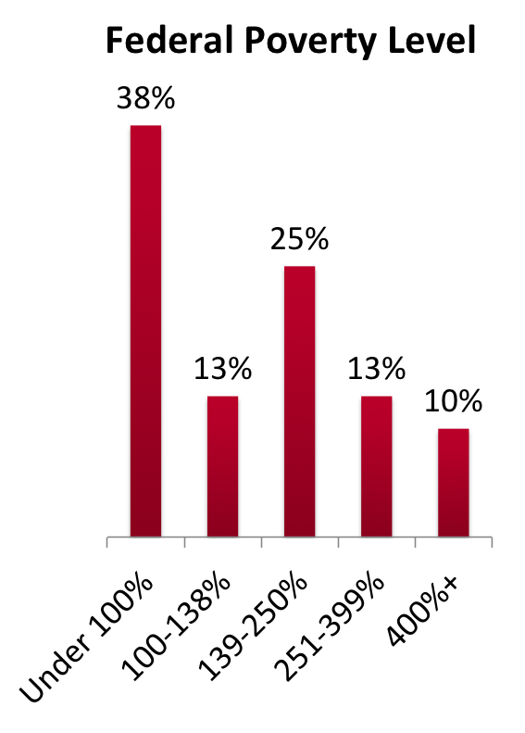
The Uninsured: Demographic Profile
(Nonelderly Uninsured, Ages 0-64)
Race/Ethnicity | Percent of Uninsured | Uninsured Rate
White (non-Hispanic) | 45% | 13%
Black (non-Hispanic) | 15% | 21%
Hispanic | 32% | 32%
Other | 8% | 18%
62%
Live in Families with at least One Full Time Worker
47%
53%
Source: Kaiser Commission on Medicaid and the Uninsured, October 2012

Slide 6
Lack of awareness creates opportunity for education + messaging
Enrollment in optional public benefit programs is well below 100%
Limited public awareness of benefits of recent health reforms
Program | % of Eligible Enrolled
Adult Medicaid | 62%
Subsidized Medicare | 33%
Medicare Rx benefit (low-income subsidy) | 40%
Unemployment benefits | 72-83%
Earned income tax credit | 80-86%
SNAP (food stamps) | 54-71%
78%
of the uninsured don’t know about the new health insurance exchanges
of people who could be eligible for the new Medicaid expansion don’t know about it
83%
Source: ASPE, March 2012; Enroll America, Nov 2012

Slide 7
Past Experiences Seeking Coverage
have shopped for insurance outside their job
have been
uninsured for 2 years or more
44%
67%
Source: Enroll America, November 2012
Notes:
ALSO ASKED- HOW DO YOU FEEL WHEN YOU’VE SHOPPED FOR COVAGE IN THE PAST? HOW DO YOU WANT TO FEEL?
WANT TO FEEL IN CONTROL, RELAXED, AND CONFIDENT
44% have shopped for insurance outside their job
67% have been uninsured for 2 years or more
They want to feel in control, relaxed, and confident about the decisions they make.

Slide 8
Four Key Messages to Reach Most Uninsured
All insurance plans will have to cover doctor visits, hospitalizations, maternity care, emergency room care, and prescriptions.
You might be able to get financial help to pay for a health insurance plan.
If you have a pre-existing condition, insurance plans cannot deny you coverage.
All insurance plans will have to show the costs and what is covered in simple language with no fine print.
One of these = top message for 89% of population
Source: Enroll America, November 2012
Notes:
A message with all four facts reaches 89% of the population and 87% of the uninsured population. This means for 89% of the population, the most important fact is one of the top four facts above.
Common key findings
Universal value of insurance
Cost and affordability are biggest barriers
Universal messages surrounding exchanges
Deep skepticism among consumers
Previous bad experience
Too good to be true
Insurance is confusing
Latinos vastly overrepresented among uninsured
Everyone wants help enrolling in coverage
A message with all four facts reached 89% of the population and 87% of the uninsured population. This means for 89% of the population, the most important fact they need to hear is one of these four.
NEW WAY TO BUY COVERAGE, HELP WITH THE COST WITH THEM. KNOWING THERE IS HELP WITH THE COST OF COVERAGE IS ESSENTIAL. KNOWING THAT THE COVERAGE THEY ARE GOING TO BUY IS ACTUALLY GOING TO GET THEM THE HELP THAT THEY NEED ARE THE THE TWO THINGS THAT GETS THEM TO FEELING SAFE SECURE.
We are putting together in-depth looks at target populations such as the clusters mentioned and also by race and income. There are minor differences- for example: amongst Latinos- in california and florida- the top motivators are financial security, your plan will be there for you, and you will be able to find a plan that fits your budget. In Texas the motivators are the same but in a different order- financial security, you will be able to find a plan that fits your budget and your plan will be there for you.

Slide 9
Clusters of Targets
Uninsured, Unnecessary & Uninterested
Reluctant but Reachable
Desperate and Believing
Connected, Low-income Women
Insured but At-Risk

Slide 10
Uninsured, but Online and Connected
Percent
Source: Enroll America, Forthcoming March 2013
Notes:
63% of uninsured adults say would be very (31%) or somewhat likely to go to the exchange website to find and compare plans if they did not have insurance in 2014.
44% of the uninsured have made a website purchase in last 3 months.
BUT, while electronic communications may be an important medium for outreach and peer-to-peer sharing of information about health coverage, our survey found that people prefer to get help in person.

Slide 11
Too Important to Do Online?
Percent
*Data provided are for all African Americans; subset for uninsured African Americans not available.
Source: Enroll America, Forthcoming March 2013
Notes:
40% of women in expansion population are uncomfortable using a website to find a plan.
53% of uninsured women think getting health insurance is too important to do online.

Slide 12
Public Perceptions
75%
Three out of four of the newly eligible want in-person assistance to learn about and enroll in coverage.
Help gets them from here…
…to here.
Confused
Overwhelmed
Worried
Helpless
Secure
Confident
Reassured
Source: Enroll America, November 2012
Notes:
78% of the public doesn’t know about the changes in coverage that are coming
83% of potentially Medicaid eligible populations don’t know changes are coming
*BUT* when people are given more information about QHPs/health insurance exchanges/premium tax credits and the possible Medicaid expansion, they are interested. However, most expect they will need help figuring out this new system.
This makes sense, because when we ask people about their experience trying to get affordable coverage in the past, most have very negative feelings associated with this experience. Having reliable, knowledgeable, accessible sources of enrollment assistance is one of the best ways to reverse these feelings and get people to a more confident, secure place when it comes to their feelings about coverage.
NOW WHAT DO THEY WANT HELP WITH?

Slide 13
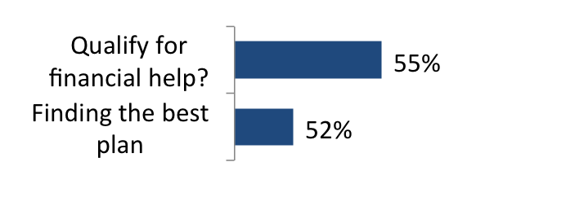
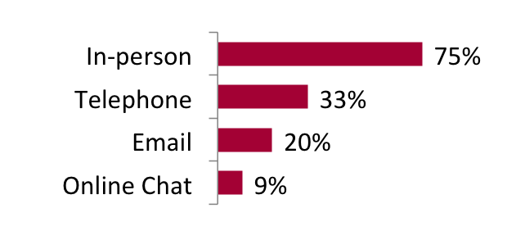
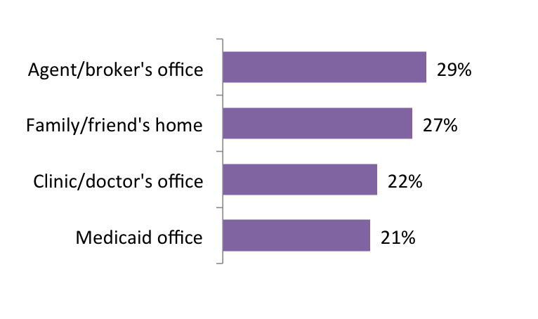
Help, I Need Somebody!
What Kind?
How?
From Whom?
Where?
Source: Enroll America, November 2012
Notes:
Which family member? Spouse (42%) or mom (20%)
OVER 1/3 OF PEOPLE SAY THAT A DOCTOR OR A NURSE IS THE MOST TRUSTED SOUCE OF INFORMATION AND MORE THAN A QUARTER WOULD WANT HELP FROM A PROVIDER.
I DON’T BELIEVE THAT SOMEONE WANTS TO SPEND THEIR 20 MINUTE VISIT TALKING ABOUT HEALTH INSURANCE OR APPLYING FOR COVERAGE. BUT IT MAKES SENSE TO CONSUMERS TO TALK ABOUT PAYING FOR THEIR CARE WITH THE PEOPLE THEY ARE PAYING FOR THEIR HEALTH CARE.
GO TO A CLINIC OR A HOSPITAL- I SEE SCRUBS AND WHITE JACKETS OF VARYING LENGTHS-I DON’T KNOW THE DIFFERENCE IN POSITIONS. WHEVER I ASK- JUST SAY THOSE 4 THINGS AND WHERE TO GO FOR HELP.

Slide 14
Understanding Assistance Options
Certified Application Counselors
In-Person Assistance Programs*
Navigators
Consumer Assistance Programs
Other Community Based Groups
Medicaid eligibility workers
Insurance Agents, Brokers
*IPA programs not available in federally facilitated exchange states.
Notes:
BRIEF MESSAGE ABOUT HELP- A LITTLE IN THE WEEDS AND A LITTLE WONKY SO BARE WITH ME:
STATES HAVE OUTSIDE BUBBLES CURRENLTY TO HELP PEOPLE GET COVERAGE (TO VARYING DEGREES)
IN THE FUTURE- THE BUBBLES IN THE CENTERS WILL ALSO EXIST.
OUTER BUBBLE= CACS
CENTER= FOR STATEBASED AND PARTNERSHIP EXCHANGES
NAVIGATORS ARE GRANTS AND IN EVERY STATE.
MESSAGE HERE- REGARDLESS OF WHO YOU ARE IN THIS ROOM- REGARDLESS OF WHAT TYPE OF ENTITY YOU REPRESENT- THERE IS A ROLE FOR YOU. YOUR ORGANIZATION, HOSPITAL, ETC CAN PROVIDE APPLICATION ASSISTANCE/

Slide 15

The Get Covered America Campaign
www.getcoveredamerica.org

Slide 16
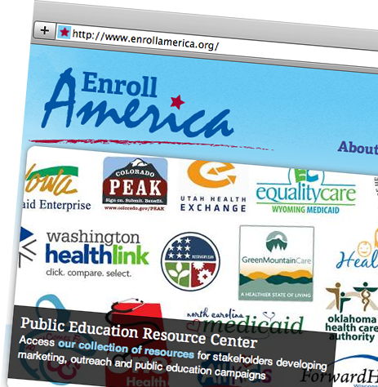
www.enrollamerica.org
More Information On:
Best practices in outreach and enrollment
Exchange branding research
Public opinion polling
Mapping tools
Statewide marketing and outreach plans
And more!

Slide 17

Questions?
  Ani Fete
  Director, State Assistance and Government Affairs
  Enroll America
  afete@enrollamerica.org
  www.enrollamerica.org

