Slide 1
AFFORDABLE CARE ACT IMPLICATIONS AND OPPORTUNITIES FOR IMPROVING ENROLLMENT FOR MENTAL HEALTH CONSUMERS
Jeffrey A. Coady, Psy.D
Substance Abuse and Mental Health Services Administration
US Department of Health and Human Services
Mental Health America
July 2013

Slide 2
All-Health and MHSA Spending in 2009

Slide 3
MH & SA Treatment Spending 2009
Notes:
86 Percent of MHSA Spending Was for MH Treatment ($147 Billion) and 14 Percent for Treatment of SUDs ($24 Billion) in 2009

Slide 4
Medicaid and Private Insurance Were the
Largest Payers of MH Treatment in 2009

Slide 5
Other State and Local Governments and Medicaid Were the Largest Payers of SA Treatment in 2009

Slide 6
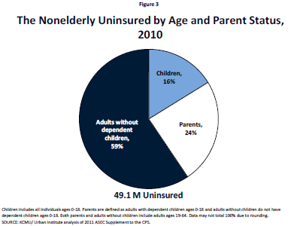
Persons Who Are Uninsured

Slide 7
Prevalence Estimates Data Sources
• National Survey on Drug Use and Health
- Sponsored by SAMHSA
- National and state estimates on prevalence of
behavioral health conditions and treatment
- 2008 - 2011 data
- Approximately 67,500 interviews per year
• American Community Survey
- Sponsored by the U.S. Bureau of the Census
- National and State population estimates, including
counts of uninsured by income level
- 2010 data
- Approximately 1.9 million persons in sample
Notes:
VISIT SAMHSA.GOV FOR STATE-SPECIFIC DATA

Slide 8
Methods for Estimating Uninsured with
M/SU Conditions by FPL
• From NSDUH, identified by State the number of
uninsured persons aged 18-64 with income:
- Between 133% and 400% of the Federal poverty level
(FPL) eligible for health insurance exchanges
- Less than 133% of the FPL eligible for Medicaid
expansion
• Calculated NSDUH prevalence rates for serious mental
illness (SMI) and substance use disorder (SUD) by
State, for the above groups
• Applied SMI/SUD prevalence rates to American
Community Survey counts of uninsured by State
Notes:
VISIT SAMHSA.GOV FOR STATE-SPECIFIC DATA

Slide 9
Prevalence of Behavioral Health Conditions Among Uninsured Adults Ages 18-64 with Incomes <400% FPL
Notes:
VISIT SAMHSA.GOV FOR STATE-SPECIFIC DATA
“Behavioral health conditions” includes unduplicated individuals with any mental illness and/or substance use disorder.
Any mental illness is conceptually and operationally defined as follows:
Any mental illness (AMI) among adults is defined as persons aged 18 or older who currently or at any time in the past year have had a diagnosable mental, behavioral, or emotional disorder as defined above, regardless of the level of impairment in carrying out major life activities. AMI is estimated based on a statistical model of a clinical diagnosis and responses to questions in the main NSDUH interview on distress (Kessler-6 [K6] scale), impairment (truncated version of the World Health Organization Disability Assessment Schedule [WHODAS]), past year MDE, past year suicidal thoughts and age.

Slide 10
PREVALENCE OF BH CONDITIONS AMONG MEDICAID EXPANSION POPULATION
CI = Confidence Interval
Sources: 2008–2011 National Survey of Drug Use and Health, 2011 American Community Survey
Notes:
VISIT SAMHSA.GOV FOR STATE-SPECIFIC DATA

Slide 11
PREVALENCE OF BH CONDITIONS AMONG EXCHANGE POPULATION
CI = Confidence Interval
Sources: 2008 – 2011 National Survey of Drug Use and Health, 2011 American Community Survey
Notes:
VISIT SAMHSA.GOV FOR STATE-SPECIFIC DATA

Slide 12
PREVALENCE OF BH CONDITIONS AMONG MEDICAID POPULATION
CI = Confidence Interval
Sources: 2008 – 2011 National Survey of Drug Use and Health, 2011 American Community Survey
Notes:
VISIT SAMHSA.GOV FOR STATE-SPECIFIC DATA

Slide 13
PREVALENCE OF BH CONDITIONS AMONG UNINSURED ADULT <400% FPL POPULATION
CI = Confidence Interval
Sources: 2008 – 2011 National Survey of Drug Use and Health, 2011 American Community Survey
Notes:
VISIT SAMHSA.GOV FOR STATE-SPECIFIC DATA

Slide 14

The Health Care Law: How It Helps
About 25 million Americans will gain
access to quality health insurance
  This includes many people with mental or substance use disorders who are currently
  uninsured or underinsured
Notes:
Many Americans are currently uninsured or underinsured. When key parts of the Health Care Law, also known as the Affordable Care Act, take effect in January 2014, about 25 million Americans will gain access to quality health insurance. This includes a significant number of individuals with mental or substance use disorders, which studies show make up nearly 30% of all uninsured people.
CMS has prepared an overview of the Health Care Law for partners and stakeholders that you might find useful. We’ve included it as Resource 1. If you would like to learn about statistics and characteristics of uninsured people with behavioral health conditions in your state or local area, click on Resource 2 [SAMHSA website with state by state prevalence data].

Slide 15
The Health Care Law: How It Helps
The Health Care Law provides for the establishment of an Essential Health Benefits package, which includes:
Ambulatory patient services
Emergency services
Hospitalization
Maternity and newborn care
Mental health and substance use disorder services, including behavioral health treatment
Prescription drugs
Rehabilitative and habilitative services and devices
Laboratory services
Preventive and wellness services and chronic disease management
Pediatric services, including oral and vision care
Notes:
The Health Care Law provides for the establishment of an Essential Health Benefit (EHB) package that includes coverage of Essential Health Benefits. The Law directs that Essential Health Benefits be equal in scope to the benefits covered by a typical employer plan and, at minimum, cover these 10 general categories. Mental health and substance use disorder services are an Essential Health Benefit that must be covered by all Qualified Health Plans.
Resource 3 describes each state’s essential benefits.

Slide 16
The Health Insurance Marketplace Makes Getting Insurance Easy
Lower
Income
Higher Income
Application
Medicaid
Children's Health Insurance Program
Premium Discounts
Qualified
Health Plans
Cost-Sharing Reductions
Single, streamlined application for public and private insurance options
All applications are applications for Medicaid!
Notes:
Through a single, streamlined application, individuals will be able to see all programs they qualify for, including Medicaid, the Children’s Health Insurance Program, Premium Discounts, Cost-Sharing Reductions, and private health insurance options known as Qualified Health Plans.
Qualified Health Plans may be of varying levels of coverage: bronze, silver, gold, and platinum. Each of these plan types will cover the 10 Essential Health Benefits, but the cost sharing for each plan will differ, and therefore the value of benefits for each plan type will differ. Bronze plans will have the least generous benefits, with greater out-of-pocket costs for enrollees, and platinum plans will have the most generous benefits. The value of benefits for silver and gold plans will fall between those of bronze and platinum plans. The Health Care Law mandates that, within the Health Insurance Marketplace, insurers must offer at least one silver and one gold plan.

Slide 17




The Health Insurance Marketplace Makes Getting Insurance Easy
Multiple convenient ways to apply
Mail
Online
Phone
In Person
Notes:
The Marketplace application is available through multiple avenues: individuals can apply online, by phone, by mail or in person.

Slide 18

Assistance Is Available to Help People Get the Best Coverage for Their Needs
Toll-free call center
Website
In-person help
  Navigators and other trained assistors
  Agents and brokers (state’s decision)
Notes:
Resources will be available for people that have questions or need help applying, including a toll-free call center, a website with plan comparison tools, and programs like the Navigator program, which individuals through the process of enrolling and using health insurance.
Community-based organizations, like ours, agents and brokers, and other third party assistors will also play a large role in helping people apply for health insurance coverage. The Health Care Law lays out ways for agents and brokers to help people enroll through the Marketplace, if the state so chooses.
It is important to note that some of the assistance resources (Marketplace call centers and websites; Navigators) will be unbiased and impartial, while others (agents and brokers; issuer web sites and call centers) will not.

Slide 19
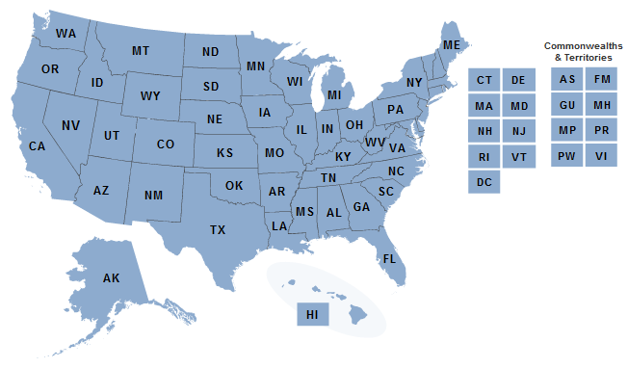
What’s Happening Where I Am?
http://www.healthcare.gov/law/information-for-you/index.html
Notes:
The way the Health Insurance Marketplace will be implemented differs by state. States are able to choose whether they want to run their own Marketplaces, have the Federal government run their Marketplace, or jointly run the Marketplace. States have the option of expanding Medicaid coverage to 133% of the Federal Poverty Level. Every state must offer coverage for mental health and substance use services as an Essential Health Benefit, although the levels of coverage will be different in each state.
New Resource 5: http://www.healthcare.gov/law/information-for-you/index.html _

Slide 20
Criminal Justice System and Eligibility
Eligibility for persons on probation, parole, or released from jail before trial.
Individuals who have been sentenced to serve time in prison or jail are not eligible to apply for private health insurance for themselves through the Marketplace, although they can apply for Medicaid before release.
However, Individuals who are in jail, but who have not pled guilty to charges or have been found guilty by a judge or jury, can apply for both private health insurance and Medicaid through the Marketplace.
The ways someone may be able to apply for health coverage through the Marketplace maybe more limited for individuals who are incarcerated, e.g. may be unlikely to have access to apply on line, can’t use some application forms.
You need to know your state Medicaid policies before you try to enroll incarcerated populations. Please contact your state or county Medicaid office for specific requirements.

Slide 21

Why is the Health Care Law Important For Substance Use Providers?
Improved consumer access to mental and substance use treatment
Lower uncompensated care burden
Equal coverage
New consumer protections
Simplified claims and payment processes
Notes:
The new Health Care Law offers several benefits for mental health and substance user providers.
Improved consumer access to mental and substance use treatment – New health insurance plans will cover “essential health benefits” that include mental health and substance use disorder services. Providers should realize increased caseloads and additional revenue. While the level of benefits will vary by state, behavioral health services will be covered to some extent in all states.
Lower compensation care burden- More than 34 million people will have access to health insurance coverage reducing providers’ uncompensated care costs.
Equal coverage- New parity regulations will provide coverage for behavioral health services equally to other chronic health conditions like diabetes, asthma and hypertension.
New consumer protections- No individual can be denied because their mental or substance use disorder is deemed a “pre-existing condition.”
Simplified claims and payment processes- The ACA reduces the administrative burdens on your practice.

Slide 22
AFFORDABLE CARE ACT
ENROLLMENT ASSISTANCE ACTIVITIES
Navigator Program (2014)
  Include at least one consumer-focused non-profit
  Required for and financed by each Exchange
  FOA for FFE/SPE Navigators closed
  At least 13 States engaged in public planning work (Feb. 27, 2013)
  AR, WA, WV, CA, CO, CT, DC, HI, MN, NV, OR, VT
In-person assistance personnel
  State-based or State-partnership Marketplaces only. State-based grants or contracts. Can be funded by Exchange Establishment grants.
Certified Application Counselors
  If State permits, Federal training and certification for Federally-facilitated and State-partnership Marketplaces (State-based can use). No dedicated funding but can use other Federal grants or Medicaid.

Slide 23
AFFORDABLE CARE ACT
ENROLLMENT ASSISTANCE ACTIVITIES
Marketplace messaging guide
  http://www.cms.gov/Outreach-and-Education/Outreach/HIMarketplace/Talking-About-the-Marketplace.pdf
ACA Enrollment assistance programs overview
  http://www.cms.gov/CCIIO/Resources/Files/Downloads/marketplace-ways-to-help.pdf
State-level navigator program activities
  https://www.statereforum.org/exchange-navigator-assister-plans
White paper on leveraging current enrollment assistance programs
  http://www.statenetwork.org/resource/building-on-a-solid-foundation-leveraging-current-programs-and-infrastructure-in-navigator-program-development/

Slide 24
SAMHSA Enrollment Coalitions Initiative
Collaborate with national organizations whose members/constituents interact regularly with individuals with mental health and/or substance use conditions to create and implement enrollment communication campaigns
Promote and encourage the use of CMS materials
Provide training and technical assistance in developing enrollment communication campaigns using these materials
SAMHSA will not be developing marketing or educational materials targeting consumers.
Channel feedback and evaluate success
Notes:
Among members and constituents
Based on these findings, SAMHSA has developed a behavioral health enrollment strategy.

Slide 25
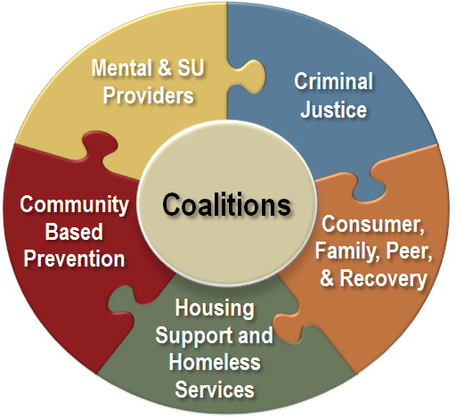
Supporting Intermediaries
Intermediary focused efforts formed in five categories:
Notes:
Consumer, Family, Peer, and Recovery Community Organizations
Faces and Voices of Recovery (FAVOR)
Mental Health America (MHA)
National Alliance on Mental Illness (NAMI)
National Council on Alcoholism and Drug Dependence (NCADD)
National Empowerment Center (NEC)
National Federation of Families for Children’s Mental Health
National Health Care for the Homeless Council (NHCHC)
National Leadership Council on African American Behavioral Health (NLC)
Young People in Recovery (YPR)
Youth MOVE National

Slide 26
SAMHSA Enrollment Coalitions Initiative UPDATE
Held two virtual meetings of coalitions to introduce the coalition initiative, preview CMS materials and discuss their dissemination; March 19 and April 7.
Created and populated an information sharing website (Onehub) for each coalition, containing all coalition meeting minutes and presentations, all CMS materials, coalition member materials and other enrollment resources.
A resource manual and training video were sent to all members. This site is updated weekly with new materials.

Slide 27
SAMHSA Enrollment Coalitions Initiative UPDATE
Soliciting and responding to requests for health insurance reform presentations at upcoming conferences and meetings.
Developing a training toolkit, an on-demand, e learning presentation and resource kit for each of the five coalitions’ national organizations to disseminate to their local members/affiliates on how to access and use CMS materials.
Communicating with coalition members regarding CMS training opportunities and new resources on a regular basis.

Slide 28

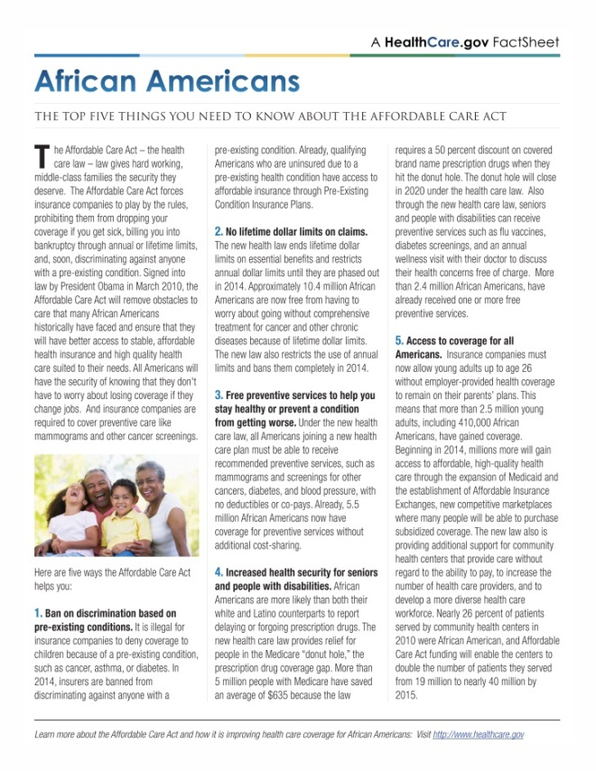

Brochures and Fact Sheets
Notes:
These fact sheets and brochures are great products that can be used by your staff when working one-on-one with [clients/consumers/patients] and as giveaways at local community events or health fairs. They provide basic information on the benefits of enrollment, what health insurance is, and how this can make health care more affordable. They can be easily downloaded and you can add your logo to the product to help direct individuals to contact your organization for more information or help around enrollment. In the next few slides, we’ll show you what’s available for different groups of individuals and in different languages. Printed copies of several items are available free through CMS; we will indicate which ones are currently available as we describe them. Use the CMS ordering widget in the dock to learn how to order them. The Resource List references which products are available to order at this time as well. More products will be produced as we get closer to the open enrollment period.

Slide 29

About the Health Insurance Marketplace
Languages:
Arabic
Chinese
Creole
English
Korean
Polish
Also available for:
Alaska Natives
American Indians
Portuguese
Russian
Spanish
Tagalog
Vietnamese
Resources 24-36 – About the Health Insurance Marketplace
Notes:
This brief brochure explains the benefits of Health Insurance Marketplace and describes what steps consumers can take to prepare before open enrollment begins in October. It is available in many different languages. Also, customized versions have been created for Alaska Natives and American Indians. Click on Resources 24-36 to access the brochures . You can order printed copies of this brochure from CMS. Click on the CMS widget on the dock to learn how.
Please provide other ideas about how to use this resource.
Resources 24-36:
About the Health Insurance Marketplace (English)
http://marketplace.cms.gov/GetOfficialResources/Publications-and-articles/about-the-marketplace-english.pdf
About the Health Insurance Marketplace – Alaska Native
http://marketplace.cms.gov/GetOfficialResources/Publications-and-articles/about-the-health-insurance-marketplace-Alaska-Native.pdf
About the Health Insurance Marketplace – American Indian
http://marketplace.cms.gov/GetOfficialResources/Publications-and-articles/about-the-health-insurance-marketplace-American-Indian.pdf
About the Health Insurance Marketplace (Arabic)
http://marketplace.cms.gov/GetOfficialResources/Other-languages/about-the-marketplace-fact-sheet-Arabic.pdf
About the Health Insurance Marketplace (Chinese)
http://marketplace.cms.gov/GetOfficialResources/Other-languages/about-the-marketplace-chinese.pdf
About the Health Insurance Marketplace (Creole)
http://marketplace.cms.gov/GetOfficialResources/Other-languages/about-the-marketplace-fact-sheet-Creole.pdf
About the Health Insurance Marketplace (Korean)
http://marketplace.cms.gov/GetOfficialResources/Other-languages/about-the-marketplace-korean.pdf
About the Health Insurance Marketplace (Polish)
http://marketplace.cms.gov/GetOfficialResources/Other-languages/about-the-marketplace-fact-sheet-Polish.pdf
About the Health Insurance Marketplace (Portuguese)
http://marketplace.cms.gov/GetOfficialResources/Other-languages/about-the-marketplace-fact-sheet-Portuguese.pdf
About the Health Insurance Marketplace (Russian)
http://marketplace.cms.gov/GetOfficialResources/Other-languages/about-the-marketplace-russian.pdf
About the Health Insurance Marketplace (Spanish)
http://marketplace.cms.gov/GetOfficialResources/Spanish-materials/about-the-marketplace-spanish.pdf
About the Health Insurance Marketplace (Tagalog)
http://marketplace.cms.gov/GetOfficialResources/Other-languages/about-the-marketplace-tagalog.pdf
About the Health Insurance Marketplace (Vietnamese)
http://marketplace.cms.gov/GetOfficialResources/Other-languages/about-the-marketplace-vietnamese.pdf

Slide 30

The Value of Health Insurance
Languages:
Arabic
Chinese
Creole
English
Korean
Polish
Portuguese
Russian
Spanish
Tagalog
Vietnamese
Also available for:
Alaska Natives
American Indians
Resources 37-49-– The Value of Health Insurance
Notes:
As a companion piece to the previous brochure, the Value of Health Insurance provides an introduction to what health insurance does, how much it costs and how it helps individuals pay for health care. The brochure is available in numerous languages and as in the earlier brochure, customized for Alaska Natives and American Indians. Click on Resources 37-49 to access these brochures. You can also order printed copies of this brochure from CMS as well.
Please provide other ideas about how to use this resource.
Resources 37-49:
The Value of Health Insurance (English)
http://marketplace.cms.gov/GetOfficialResources/Publications-and-articles/value-of-health-insurance-english.pdf
The Value of Health Insurance- Alaska Native
http://marketplace.cms.gov/GetOfficialResources/Publications-and-articles/value-of-health-insurance-Alaska-Native.pdf
The Value of Health Insurance- American Indian
http://marketplace.cms.gov/GetOfficialResources/Publications-and-articles/value-of-health-insurance-American-Indian.pdf
The Value of Health Insurance (Arabic)
http://marketplace.cms.gov/GetOfficialResources/Other-languages/value-of-health-insurance-Arabic.pdf
The Value of Health Insurance (Chinese)
http://marketplace.cms.gov/GetOfficialResources/Other-languages/value-of-health-insurance-chinese.pdf
The Value of Health Insurance (Creole)
http://marketplace.cms.gov/GetOfficialResources/Other-languages/value-of-health-insurance-Creole.pdf
The Value of Health Insurance (Korean)
http://marketplace.cms.gov/GetOfficialResources/Other-languages/value-of-health-insurance-korean.pdf
The Value of Health Insurance (Polish)
http://marketplace.cms.gov/GetOfficialResources/Other-languages/value-of-health-insurance-Polish.pdf
The Value of Health Insurance (Portuguese)
http://marketplace.cms.gov/GetOfficialResources/Other-languages/value-of-health-insurance-Portuguese.pdf
The Value of Health Insurance (Russian)
http://marketplace.cms.gov/GetOfficialResources/Other-languages/value-of-health-insurance-russian.pdf
The Value of Health Insurance (Spanish)
http://marketplace.cms.gov/GetOfficialResources/Spanish-materials/value-of-health-insurance-spanish.pdf
The Value of Health Insurance (Tagalog)
http://marketplace.cms.gov/GetOfficialResources/Other-languages/value-of-health-insurance-tagalog.pdf
The Value of Health Insurance (Vietnamese)
http://marketplace.cms.gov/GetOfficialResources/Other-languages/value-of-health-insurance-vietnamese.pdf

Slide 31

The Top Five Things You Need to Know About the ACA
Languages:
English
Spanish
Available for:
African-Americans
Asian-Americans and Pacific Islanders
Families with children
Health care providers
Latinos
LGBT
People with disabilities
Seniors
Young Adults
Resources 50-64 – The Top Five Things You Need to Know About the ACA
Notes:
These fact sheets provide a quick, easy to understand overview of what different groups of individuals should consider about the ACA. Easy to print, they are available in both Spanish and English. They can be put in racks or on desks throughout your offices or handed directly to patients and clients when you meet with them. Click on Resources 50-64 to download these fact sheets.
Please provide other ideas about how to use this resource.
Resources 50-64:
The Top Five Things You Need to Know About the ACA – African Americans
http://wayback.archive-it.org/3626/20130619175522/http://www.healthcare.gov/news/brochures/african-americans-top5.pdf
The Top Five Things You Need to Know About the ACA – Asian Americans & Pacific Islanders
http://wayback.archive-it.org/3626/20130619175524/http://www.healthcare.gov/news/brochures/asian-american-pacific-islander-top5.pdf
The Top Five Things You Need to Know About the ACA – Families with Children
http://wayback.archive-it.org/3626/20130619175506/http://www.healthcare.gov/news/brochures/families-with-children-top5.pdf
The Top Five Things You Need to Know About the ACA – Families with Children (Spanish)
http://wayback.archive-it.org/3626/20130619175525/http://www.healthcare.gov/news/brochures/families_with_children_top5_spanish.pdf.pdf
The Top Five Things You Need to Know About the ACA – Healthcare Providers
http://wayback.archive-it.org/3626/20130619175526/http://www.healthcare.gov/news/brochures/health-care-providers-top5.pdf
The Top Five Things You Need to Know About the ACA – Healthcare Providers (Spanish)
http://wayback.archive-it.org/3626/20130619175528/http://www.healthcare.gov/news/brochures/health_care_providers_top5_spanish.pdf.pdf
The Top Five Things You Need to Know About the ACA – Latinos
http://wayback.archive-it.org/3626/20130619175529/http://www.healthcare.gov/news/brochures/latinos-top5.pdf
The Top Five Things You Need to Know About the ACA – Latinos (Spanish)
http://wayback.archive-it.org/3626/20130619175530/http://www.healthcare.gov/news/brochures/latinos-top5-spanish.pdf
The Top Five Things You Need to Know About the ACA – LGBT
http://wayback.archive-it.org/3626/20130619175530/http://www.healthcare.gov/news/brochures/lgbt-top5.pdf
The Top Five Things You Need to Know About the ACA – People with Disabilities
http://wayback.archive-it.org/3626/20130619175534/http://www.healthcare.gov/news/brochures/people-with-disabilities-top5.pdf
The Top Five Things You Need to Know About the ACA – People with Disabilities (Spanish)
http://wayback.archive-it.org/3626/20130619175535/http://www.healthcare.gov/news/brochures/people-with-disabilities-top5-spanish.pdf
The Top Five Things You Need to Know About the ACA – Seniors
http://wayback.archive-it.org/3626/20130619173934/http://www.healthcare.gov/news/brochures/seniors-top5.pdf
The Top Five Things You Need to Know About the ACA – Seniors (Spanish)
http://wayback.archive-it.org/3626/20130619175536/http://www.healthcare.gov/news/brochures/seniors_top5_spanish.pdf.pdf
The Top Five Things You Need to Know About the ACA – Young Adults
http://wayback.archive-it.org/3626/20130619175544/http://www.healthcare.gov/news/brochures/young-adults-top5.pdf
The Top Five Things You Need to Know About the ACA – Young Adults (Spanish)
http://wayback.archive-it.org/3626/20130619175548/http://www.healthcare.gov/news/brochures/young_adults_top5_spanish.pdf.pdf

Slide 32


The Health Care Law and You—Brochure
Languages:
English
Spanish
Resources 65-66 – The Health Care Law and You Brochure
Notes:
These brochures provide an overview of the benefits of the Health Care Law in simple language. Click on Resources 65-66 to download these brochures. This content is also available in video and PowerPoint training formats so you can do group presentations or just have the video running in your offices for people to view as they wait.
Please provide other ideas about how to use this resource.
Resources 65-66:
The Health Care Law and You – Brochure (English)
http://wayback.archive-it.org/3626/20130619175507/http://www.healthcare.gov/news/brochures/health-care-law-and-you.pdf
The Health Care Law and You - Brochure (Spanish)
http://wayback.archive-it.org/3626/20130619175515/http://www.healthcare.gov/news/brochures/health-care-law-and-you-spanish.pdf

Slide 33



Additional Fact Sheets
Languages:
English
Spanish
Resources 67-68 – Key Dates for the Health Insurance Marketplace
Resources 69-70 – Get Ready to Enroll in the Marketplace
Resources 71-72 – Things to Think About When Choosing a Health Plan
Notes:
These additional fact sheets provide information about how to get ready to enroll in the marketplace, things to think about when choosing a health plan, and key dates to keep in mind. These fact sheets are available in both English and Spanish.
Resources 67-72:
Key Dates for the Health Insurance Marketplace (English)
http://marketplace.cms.gov/GetOfficialResources/Publications-and-articles/key-dates-for-the-health-insurance-marketplace.pdf
Key Dates for the Health Insurance Marketplace (Spanish)
http://marketplace.cms.gov/GetOfficialResources/Spanish-materials/key-dates-for-the-health-insurance-marketplace-spanish.pdf
Get Ready to Enroll in the Marketplace (English)
http://marketplace.cms.gov/GetOfficialResources/Publications-and-articles/get-ready-to-enroll-in-the-marketplace.pdf
Get Ready to Enroll in the Marketplace (Spanish)
http://marketplace.cms.gov/GetOfficialResources/Spanish-materials/get-ready-to-enroll-in-the-marketplace-spanish.pdf
Things to Think About When Choosing a Health Plan (English)
http://marketplace.cms.gov/GetOfficialResources/Publications-and-articles/things-to-think-about-when-choosing-a-plan.pdf
Things to Think About When Choosing a Health Plan (Spanish)
http://marketplace.cms.gov/GetOfficialResources/Publications-and-articles/things-to-think-about-when-choosing-a-plan-spanish.pdf

Slide 34

Videos
Notes:
To help explain health care reform and the benefits and options offered through the Health Insurance Marketplace, there are several videos available for you to use with your organization and directly with your patients and clients. We’ll describe the various types and provide links in the next few slides.

Slide 35

Real-Life Testimonials
Videos that show how people without insurance like Jaime are preparing to enroll in the new coverage options this fall
Resource 73 – Life Without Health Insurance: Jaime’s Story
Notes:
In a series of short testimonial videos of “real life” experiences, people like Jaime describe life without health insurance and discuss their plans to enroll in the new health coverage options available this fall through the Health Insurance Marketplace. Click Resource 73 to watch Jaime talk about how she is looking forward to obtaining health insurance through the Marketplace.
Resources 73:
Life Without Health Insurance: Jaime’s Story
http://www.youtube.com/watch?v=tqQwML2O19Q&feature=player_profilepage

Slide 36
Other SAMHSA Resources
Office of Behavioral Health Equity is working with African American, Latino, Native American and Asian American organizations to develop and promote best practices for CBOs to enroll eligible populations
CMHS’ SOAR project training to assist access to entitlement programs for homeless populations will incorporate enrollment training
BRSS TACS is managing eight awards to recovery CBOs in eight different states to build collaboration and disseminate information about state enrollment activities and effective outreach strategies.
Notes:
Listed
SAMHSA will share other training and technical assistance resources currently in development. are examples of enrollment assistance projects underway and in development. More may be coming.

Slide 37
Illinois TASC Project
SAMHSA has funded a partnership with TASC to
  Identify a core set of best practices for community-based organizations performing health insurance enrollment assistance for the pre-adjudication status population and community re-entry population;
  Create a written summary of the practices identified; and
  Work with the BHBusiness project to develop a training curriculum that would support broader adoption of these best practices and encourage line officers and providers-- probation, parole, correctional officers, jail social workers, etc. -- to facilitate enrollment for people under their direct care.

Slide 38
BHBusiness
TA to help 900+ provider orgs/year in 5 areas of practice
  Strategic business planning in an era of health reform
  3rd-party contract negotiations
  3rd-party billing and compliance
  Health insurance eligibility determinations and enrollment
  Health information technology adoption
Special focus on providers of peer & recovery support services & providers serving racial & ethnic minority and other vulnerable populations
http://bhbusiness.org.
38

Slide 39
Enrollment Resources
The Marketplace Homepage
  https://www.healthcare.gov/
HHS Partners Resources
  http://www.cms.gov/Outreach-and-Education/Outreach/HIMarketplace/index.html
SAMHSA Health reform resources
  http://www.samhsa.gov/healthReform/
Behavioral Health Needs Assessment Tool-kit for States
  http://www.statereforum.org/sites/default/files/samhsa_bh_needs_assessment_.pdf

Slide 40
Contact Information
Jeffrey A. Coady, Psy.D
233 North Michigan Avenue,
Suite 200
Chicago, Il 60601
312-353-1250
Jeffrey.Coady@samhsa.hhs.gov
www.SAMHSA.gov/healthreform

